Slide 1
How to Give a Talk, Read a Paper, and Manage Citations
Ian T. Beck
2025 CCQC Summer Lecture Series

Slide 2
How to Give a Scientific Talk
And general tips for scientific communication

Slide 3

Scientific Communication
Important to be able to effectively communicate your research
Know your audience
What is their background of understanding?
Practice!
Group meetings
Extra practices
Know the setup
Make sure the room is available

Slide 4

Elevator Pitch
Give a short and sweet summary of your research
No longer than an elevator ride (~60 sec)
Captivate your audience, make them want to know more
Practice extensively
Use visuals (poster presentation)

Slide 5
Giving a Talk
To get better at giving talks you must give more talks
Pay attention to other talks
What did you like about what their presentation?
How do they captivate their audience?
What do they do effectively that you can improve on?
Be enthusiastic about what you are presenting
Have confidence in your knowledge
You are the expert in the room

Slide 6
Bullet Points
When you have extensive bullet points it can distract the audience and from your talking and instead makes them focus on reading a whole paragraph that may or may not make sense to the context of the presentation and its especially bad when its just one long run-on sentence with no punctuation and generally bad grammar and by the time the audience is done reading your bullet point you’re already on to the next slide and now their lost and they are confused the rest of the presentation
Use bullet points appropriately
Keep them short and sweet, when possible
Be consistent
Grammar is still important

Slide 7
Visual Elements of the Talk
Details are important
Don’t mix fonts
Or font sizes
Choose a theme when starting a presentation
Be consistent throughout
Be careful when using PowerPoint!
UGA has nice themes if you aren’t creative

Slide 8
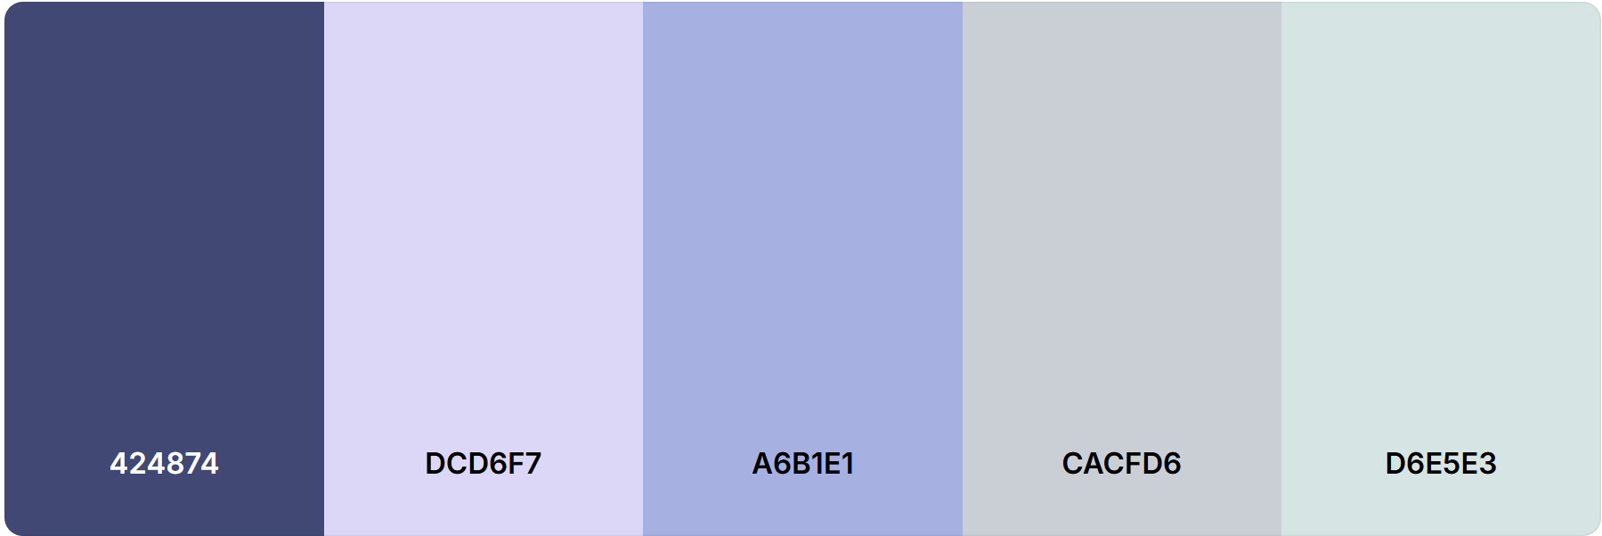
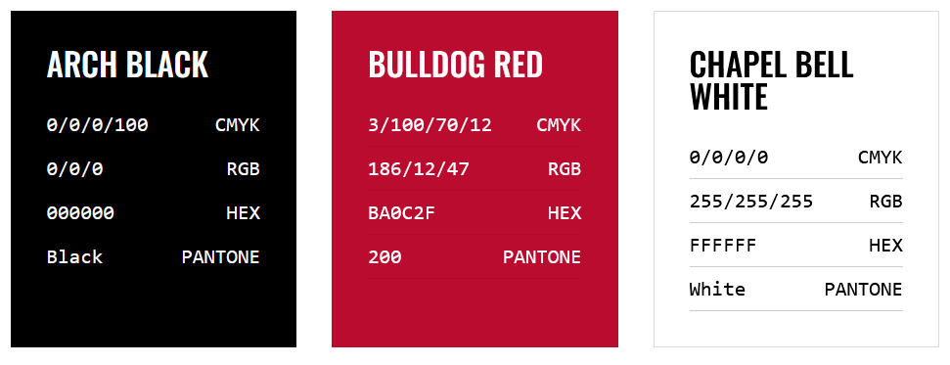
Visual Elements of the Talk
When making your own theme, use a color palette
When using a UGA theme, use their specific color palette
https://coolors.co/
https://brand.uga.edu/visual-style/

Slide 9
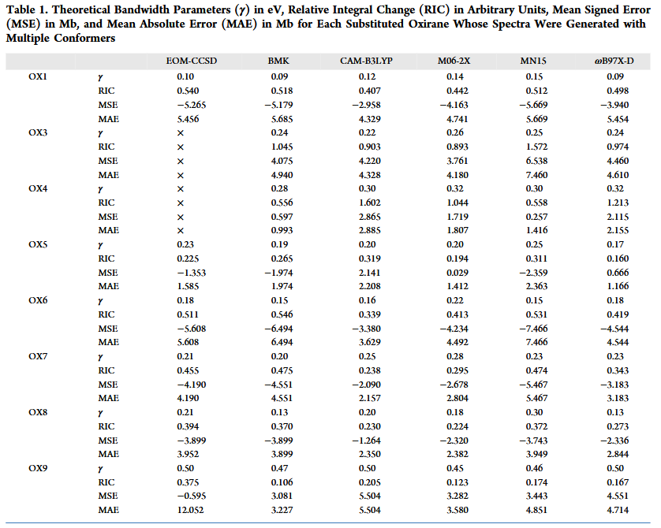
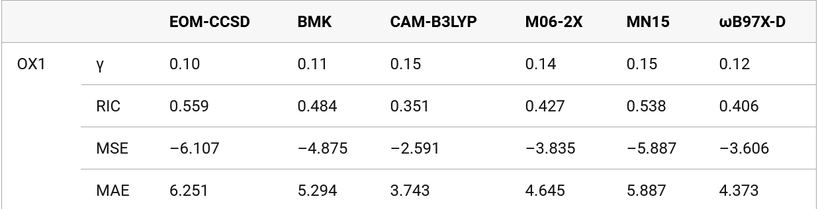
Don’t: Include unnecessary info
No one likes looking at large tables
Do: highlight important info in tables
Take it one step at a time

Slide 10
Visuals in a Talk
Use high quality images
Resolution in here is higher than rm 1218
Use appropriate animations
Don’t animate slide changes
Use animations in figures and text
Bring information in as you talk about it
Use this to control your audience's attention

Slide 11

First synthesis of “three-dimensional microscopic semiconductor crystals” in molten glass matrix
³Ekimov, A. I.; Onushchenko, A. A. JETP Lett. 1981, 34(6)
First synthesis of “crystalline CdS particles” in colloidal suspension
⁴Rossetti, R.; Nakahara, S.; Brus, L. E. J. Chem. Phys. 1983, 79(2)
Event
1982
1986
1981
1983
xxxx
Model proposed to explain the optical line shifts observed as a function of sphere radius
⁵Éfros, Al. L.; Éfros, A. L. Sov. Phys. Semicond. 1982, 16(7)
The term “quantum dot” was first used
⁶Reed, M. A. et. al. J. Vac. Sci. Technol. B. 1986, 4(1)
Timeline of Quantum Dots
Notes:
1. In 1981 Ekimov and Onushchenko were examining the size effects of semiconductors and grew CuCl crystals of sizes varying from tens to hundreds of angstroms in a molten glass matrix. They found a wave shift in the exciton absorption spectra of up to 0.1 eV which was caused by what they called a “quantum size effect”.
2. In 1982 Éfros and Éfros wanted to explain the shift that Ekimov and Onushchenko described was a result of radius of their semiconductor crystals. They derived quantities that relate radius size to conductivity which allowed them to relate radius size to absorption coefficients of light. They did this for various system bounds, with a particle-in-a-sphere problem as their starting point
3. In 1983 Brus and co-workers reported the first synthesized quantum dot in a colloidal suspension. They noted size effects of electronic properties, specifically red shifting in resonance Raman and absorption spectra as size increased.
4. In 1986 the term quantum dot was first used to describe “completely spatially quantum system … where the carriers have zero degrees of freedom”

Slide 12
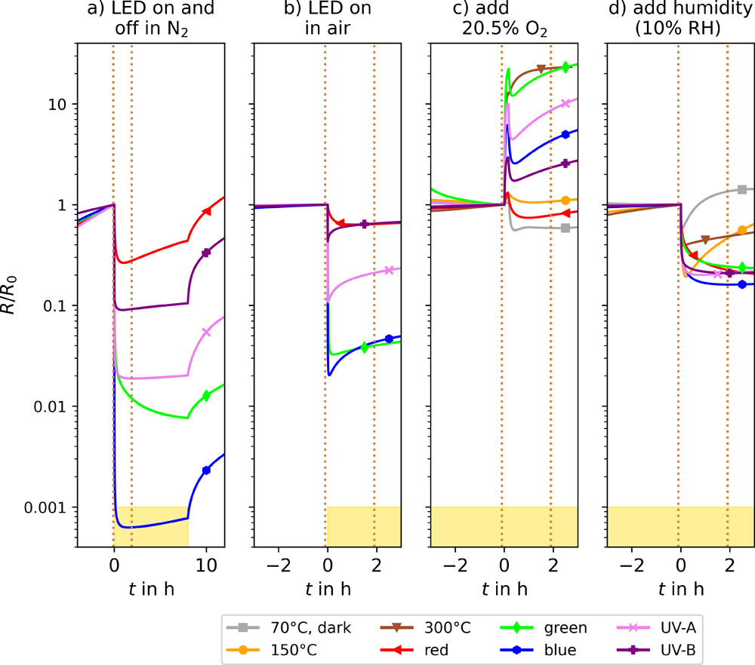
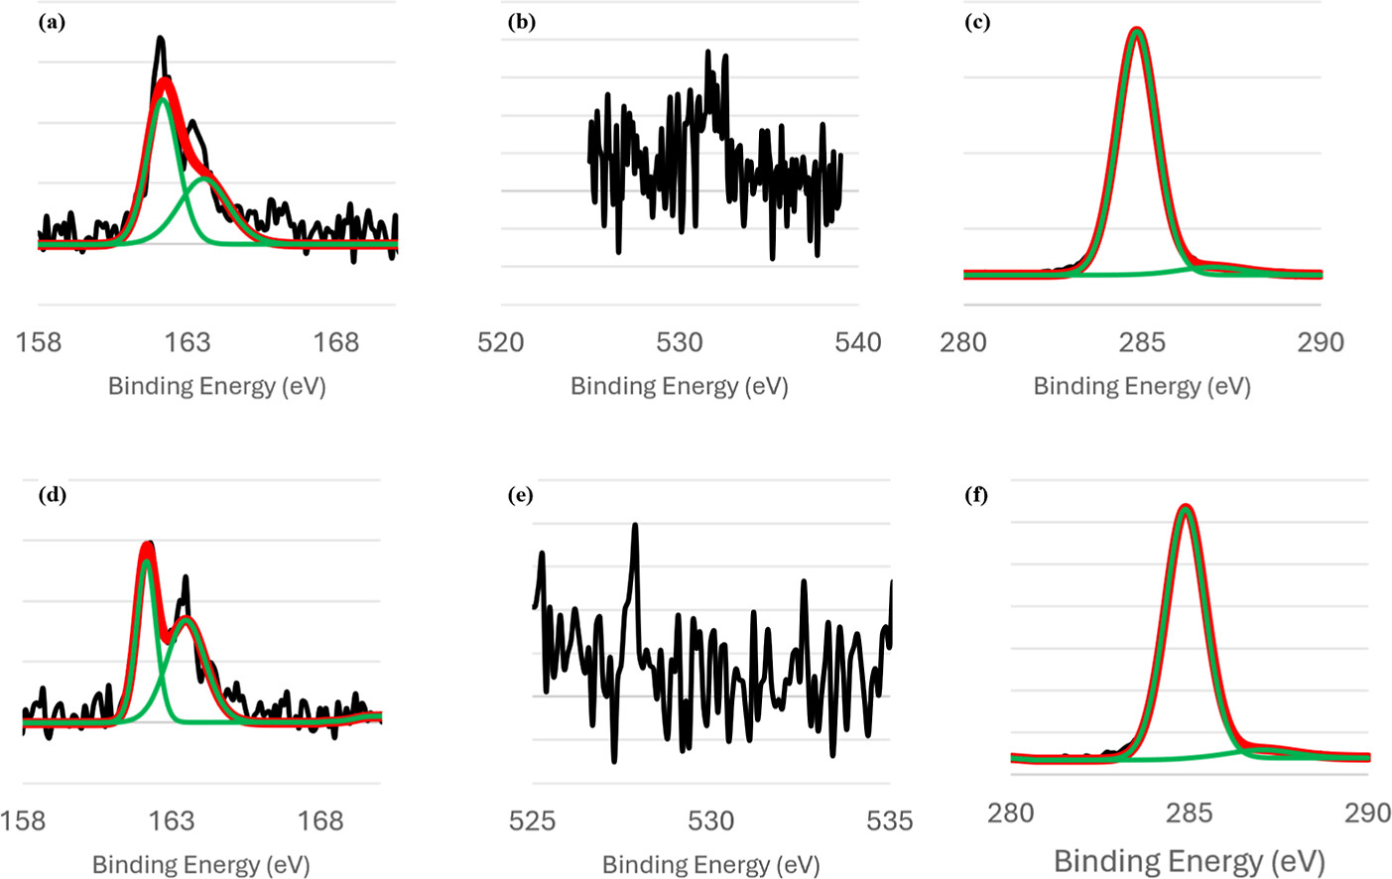
Visuals in a Talk
Don’t use funky colors
Be aware of color blindness when making figures
J. Phys. Chem. C 2025, 129, 21, 9844–9856
J. Phys. Chem. C 2025, 129, 21, 9795–9800

Slide 13
References in a Talk
Be consistent throughout the talk
Numbering (a,b,c,… or 1,2,3…)
ACS style
Don’t include a full citation
Include enough info for someone to look it up
Too Long
Beck, I. T.; Mitchell, E. C.; Hill, A. W.; Turney, J. M.; Rotavera, B.; Schaefer, H. F. “Evaluating the Importance of Conformers for Understanding the Vacuum-Ultraviolet Spectra of Oxiranes: Experiment and Theory” J. Phys. Chem. A 2024, 128, 50, 10906–10920.
Better
Beck, I. T.; et al. J. Phys. Chem. A 2024, 128, 50, 10906–10920.

Slide 14
Some Last Tips
Dress to impress
Be prepared for questions
Don’t stand still
Bring water
Make a backup plan
Practice with a clicker
Don’t use Google slides or PowerPoint Online

Slide 15
Giving a Talk Summary
Be consistent throughout your presentation
Use a visually appealing theme
Control your audience's attention with animations
Don’t include unnecessary information
Use thoughtful visuals and high-resolution images
Include references
Practice!

Slide 16
How to Read a Paper and Manage Citations

Slide 17
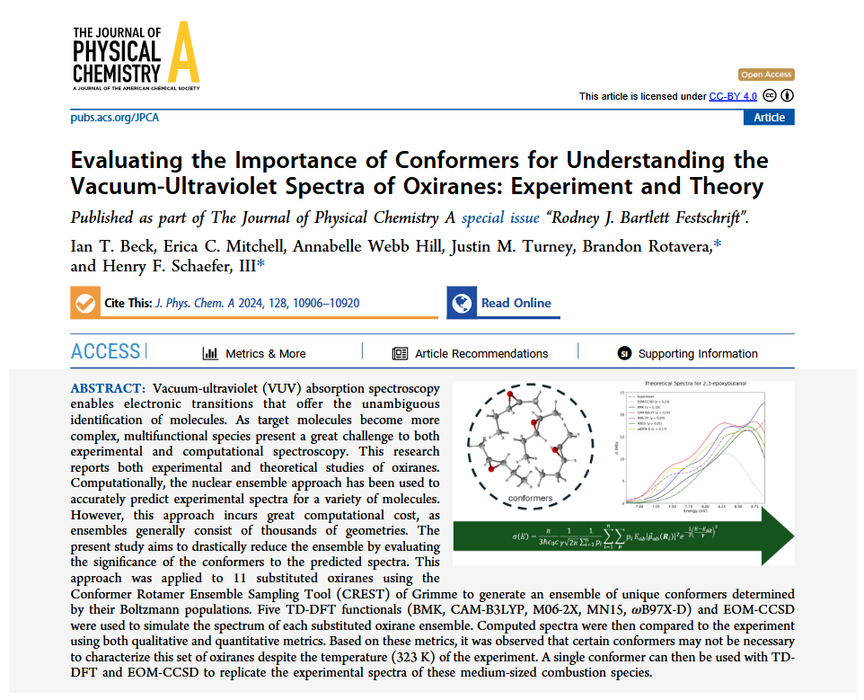
Reading a Paper
“Why am I reading this paper?”
Skim before reading
Title
First place to look
“Does this pertain to what I’m looking for?”
Abstract
Quick summary of everything

Slide 18
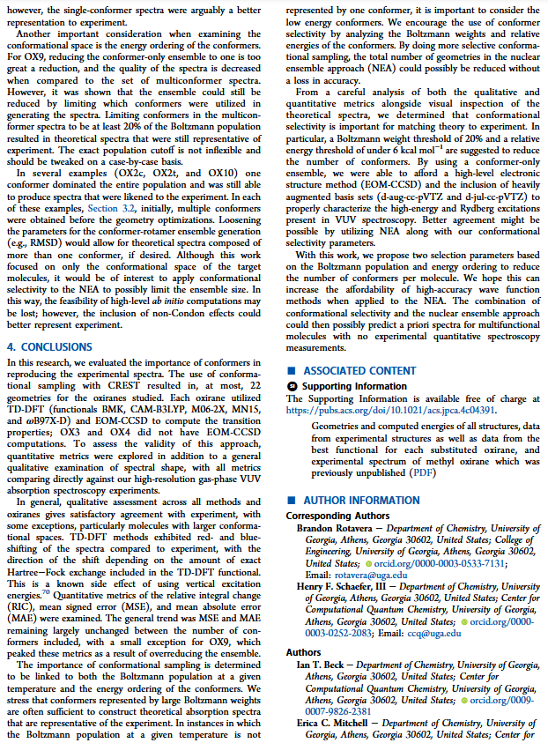
Reading a Paper
Conclusions
What were the findings of the paper and what does it imply
Pause
“Am I interested in the results of this paper?”
“Would reading more further my knowledge?”

Slide 19
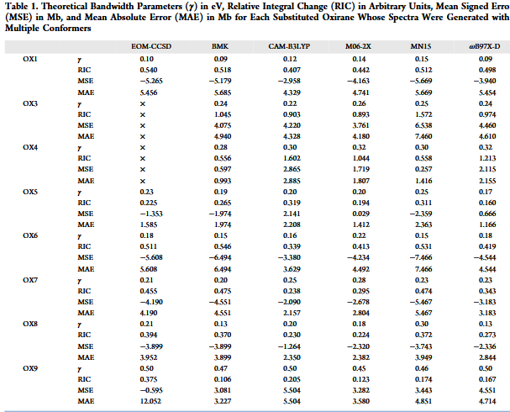
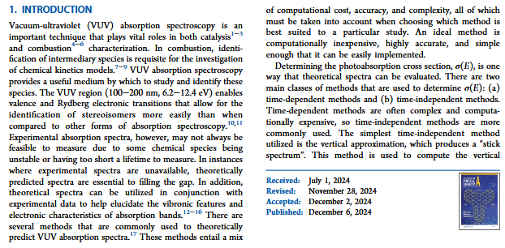
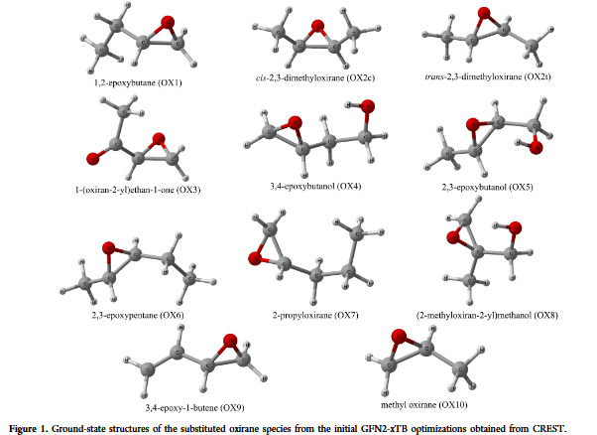
Reading a Paper
Introduction
Skim the first few paragraphs
Subject background
Great for references when writing a paper
Results
Scan figures and tables
Look for important results

Slide 20
After Skimming the Paper
“Am I interested enough to read thoroughly?”
Don’t read every paper
Save it for later
Follow the reference trail
Look at papers in the intro
What other papers did the paper cite?
Who has cited this paper? (Crossref, GoogleScholar)
A paper a day makes a doctor, hooray! (practice!)

Slide 21
How to Find Papers
Journal databases
Web of Science, GoogleScholar, SciFinder n
arXiv
Keywords, author experts, chemical structure
Follow the paper trail

Slide 22
Managing References
Staying organized
Cite as you write
Keep notes on papers
Print important papers for handwritten notes
Use a reference manager
Overleaf/LaTeX
Mendeley
Zotero

Slide 23
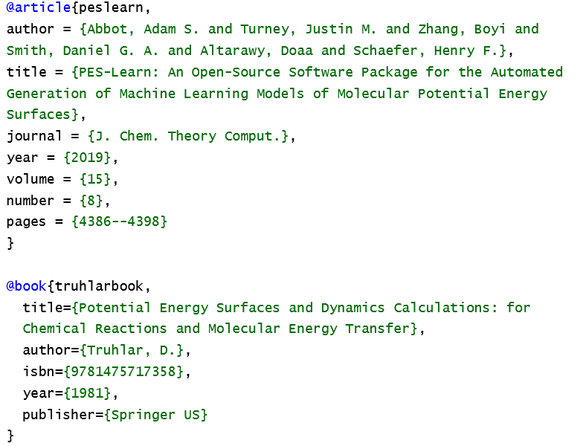
Overleaf/LaTeX
Why manage references when you can just write them in your paper files?
Can’t keep notes
Difficult to save a paper for later
Very disorganized
Would not recommend

Slide 24
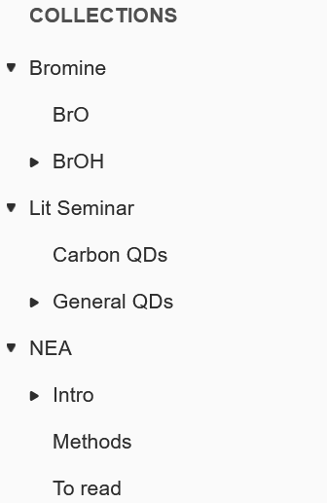
Mendeley
Download papers and keep them all in one place (web and desktop)
Take notes and highlight in pdfs
Sort papers into categories
Lets you know which papers you haven’t read
Organize by author, year, journal, etc.
Will export bib in different forms
Not great at extracting info from pdfs

Slide 25
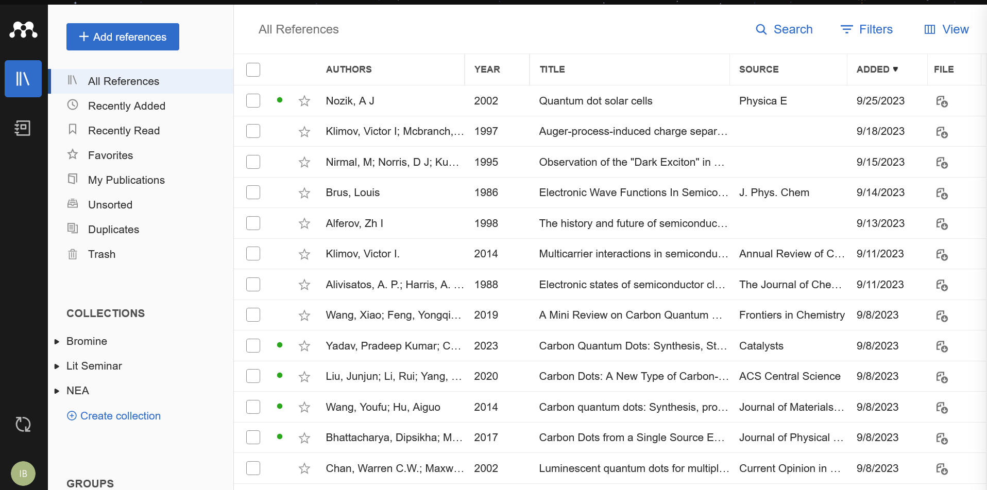
Mendeley

Slide 26
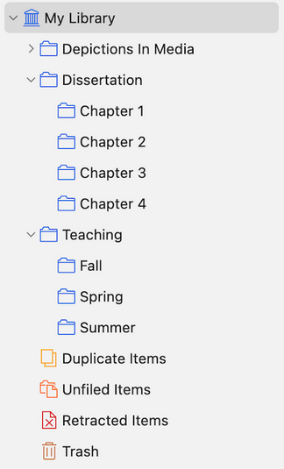
Zotero
Keeps papers all in one place
Don’t need to download files with browser extension
Desktop app only
Take notes and highlight in pdfs
Sort papers into categories
Organize by author, year, journal, etc.
Will export bib in different forms
Nice documentation

Slide 27
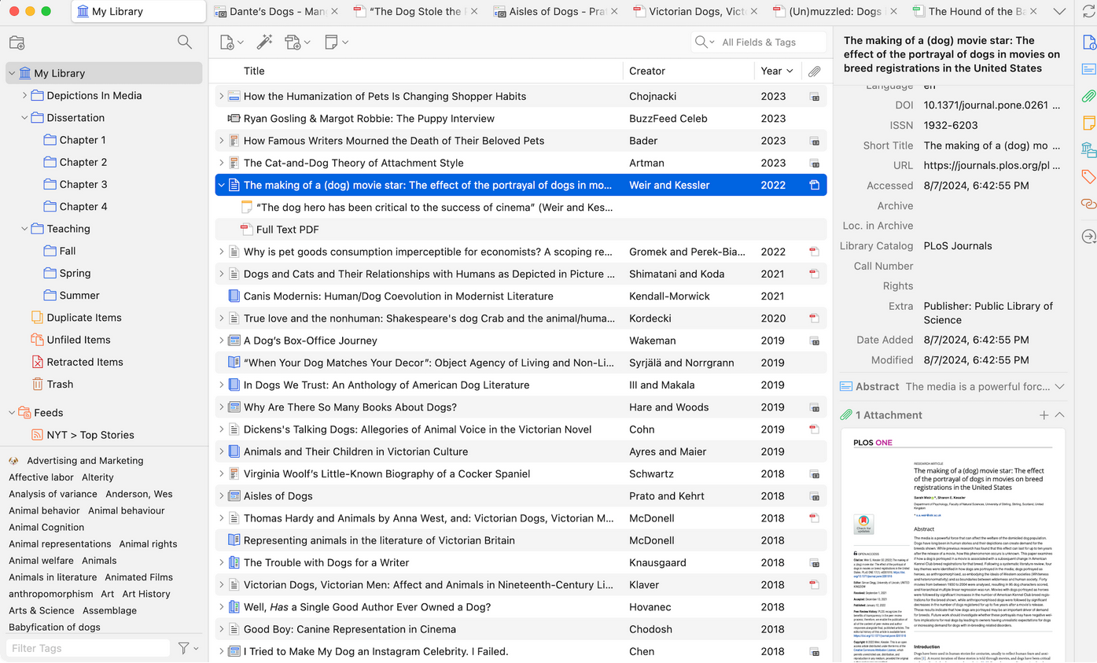

Slide 28
Thank you!
Questions?

